Slide 1

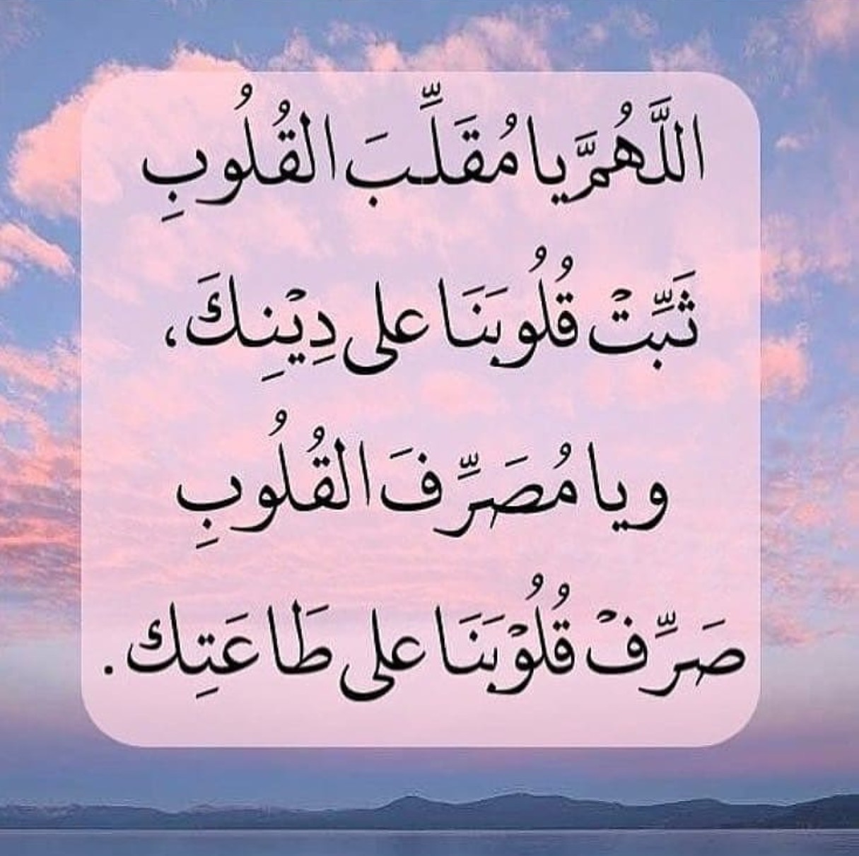


Slide 2



Slide 3

Unit 7

Slide 4
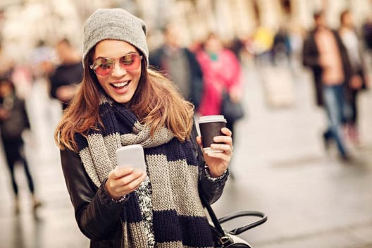
Opener

Slide 5
a) whose
Complete the following sentences:
I didn’t enjoy the movie ……………….. I watched yesterday.
b) who
c) which
d) where

Slide 6
a) when
Complete the following sentences:
I was helping my mother ……………….. my aunt visited us.
b) while
c) as
d) that

Slide 7
a) when
Complete the following sentences:
I can’t remember the day ……………….. we met.
b) who
c) whose
d) that

Slide 8
a) so
Complete the following sentences:
I studied hard ……………….. I didn’t get high marks.
b) but
c) in order to
d) and

Slide 9
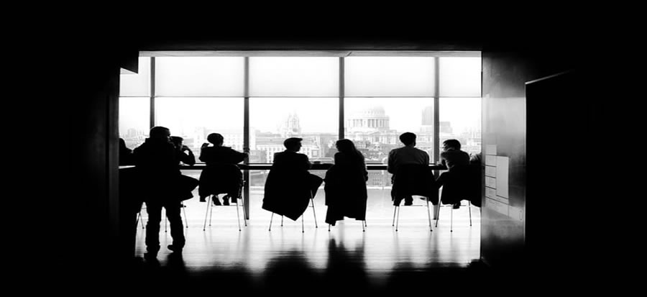


Slide 10


Slide 11




In pairs, look at the icons and name the applications.

Slide 12
What do they have in common?

Slide 13
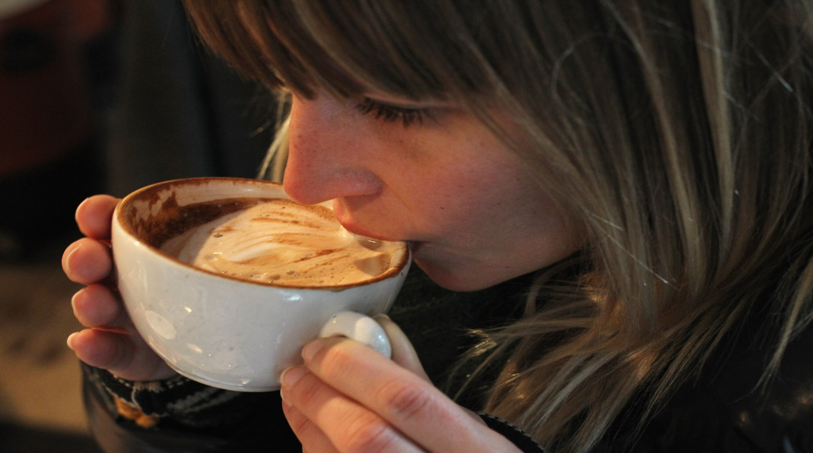
The girl is addicted to coffee. When she doesn’t drink coffee she gets a headache and she feels super tired.

Slide 14
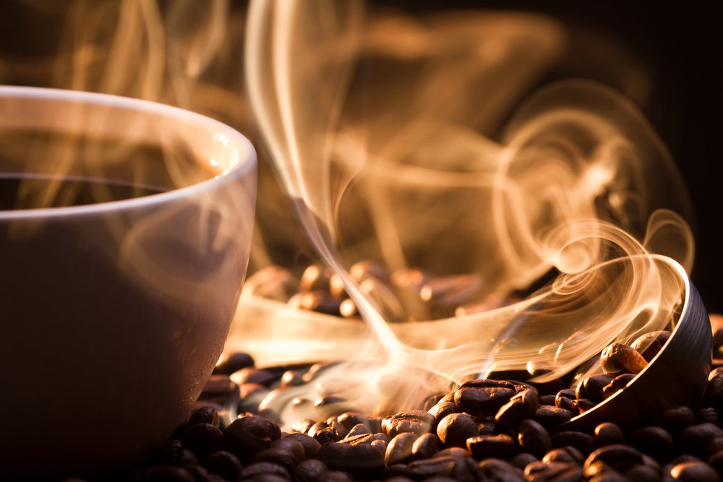
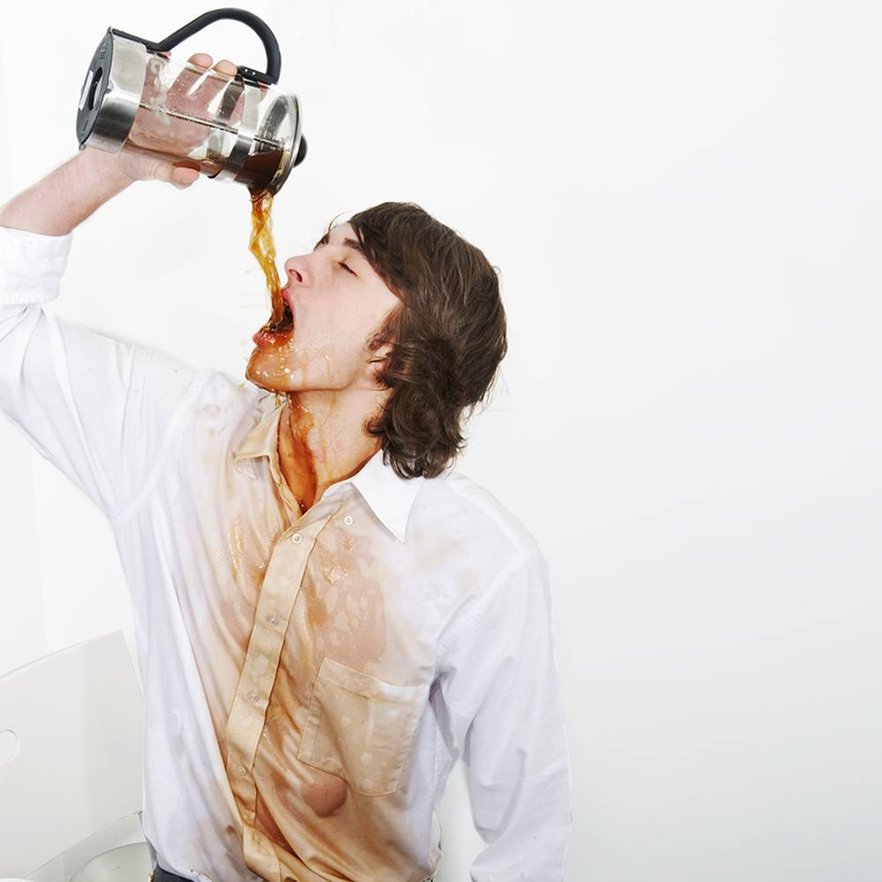
How can this person overcome his addition?

Slide 15
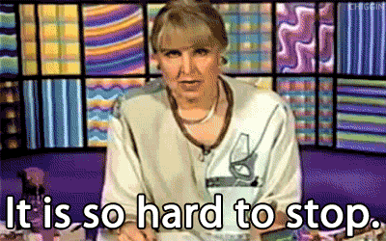
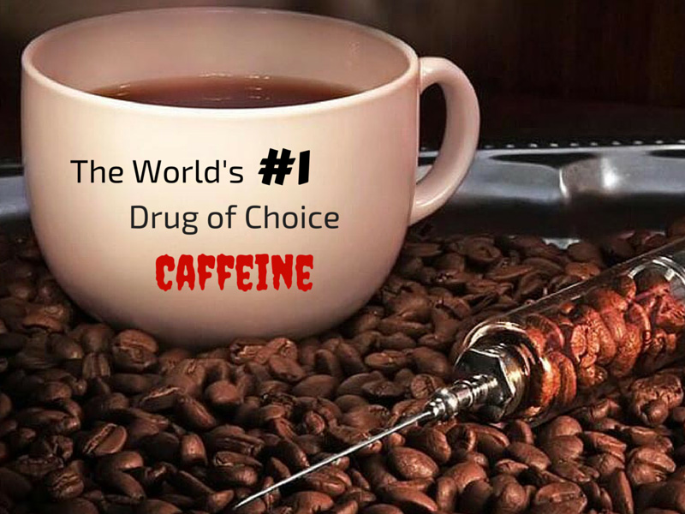

addiction
an inability to stop doing or using something

Slide 16
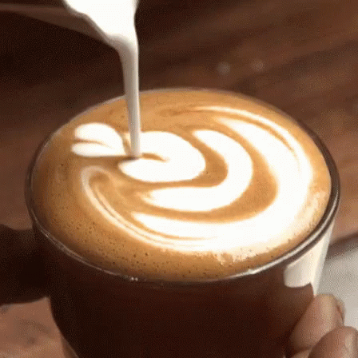
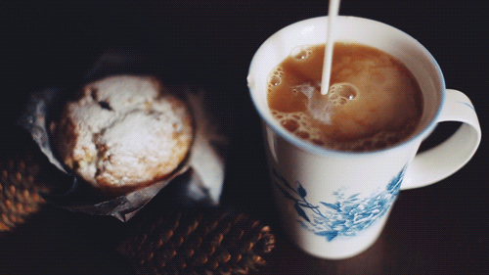
Drinking coffee is not necessarily a bad thing. Just don’t drink a lot of it!

Slide 17
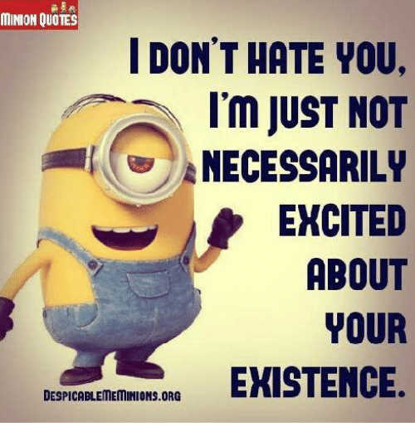

necessarily
used in negatives to mean "in every case" or "therefore"

Slide 18
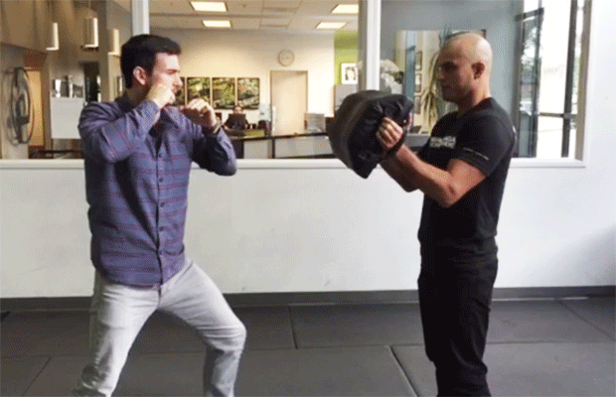
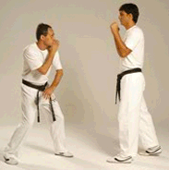
Some sports teach people to defend themselves.

Slide 19
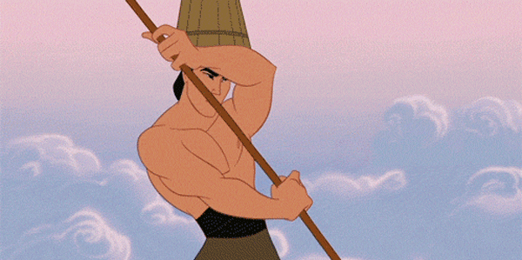
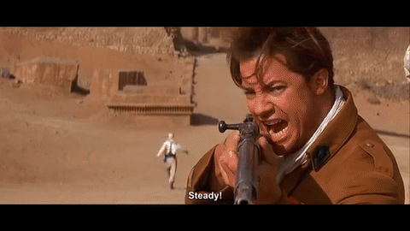
defend
to protect someone or something against attack or criticism; to speak in favour of someone or something

Slide 20
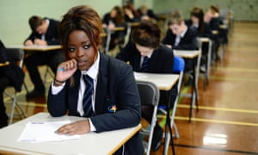
Students are always obsessed with exam results.

Slide 21
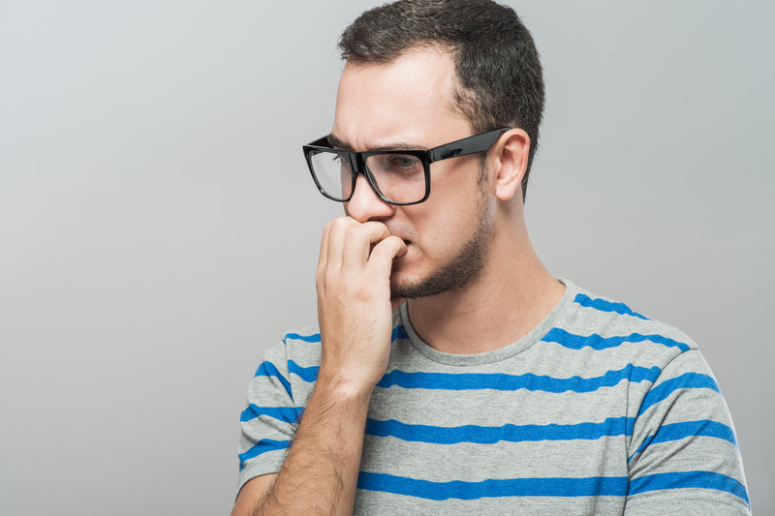
obsessed
unable to stop thinking about something; too interested in or worried about something

Slide 22
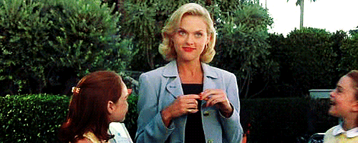
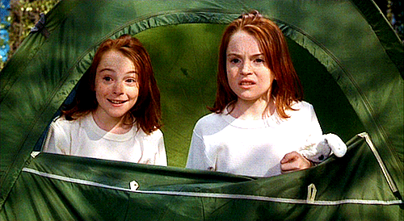
The twins look very much alike. People often confuse the girl with her twin.

Slide 23
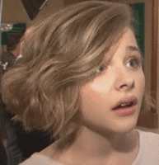
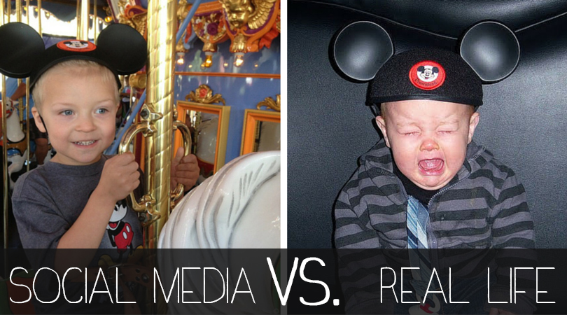
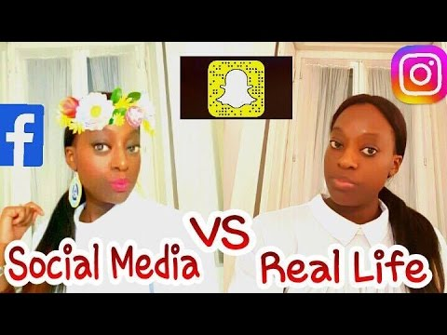
confuse
to mistake somebody or something for somebody or something else

Slide 24
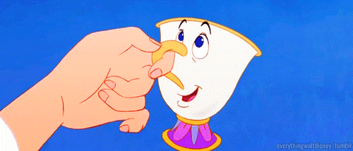
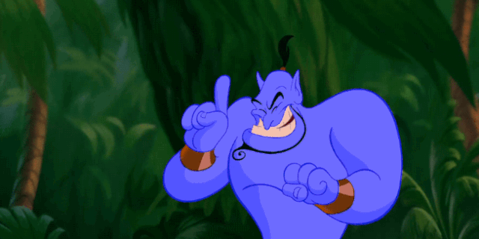
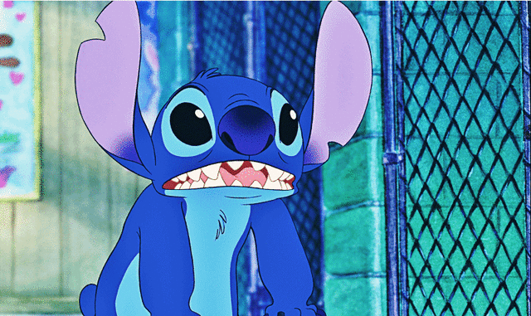
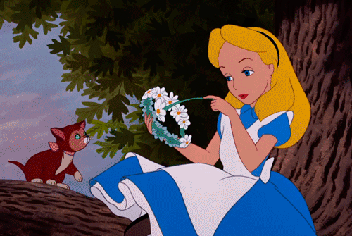
There are many unrealistic characters in movies.

Slide 25
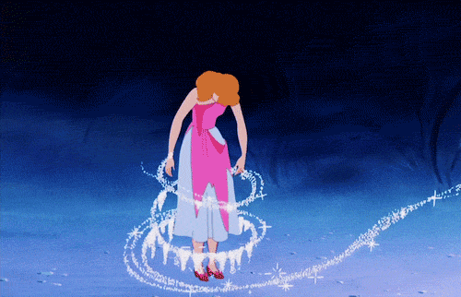
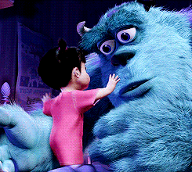
unrealistic
having a wrong idea of what is likely to happen or of what you can really do; not based on facts

Slide 26
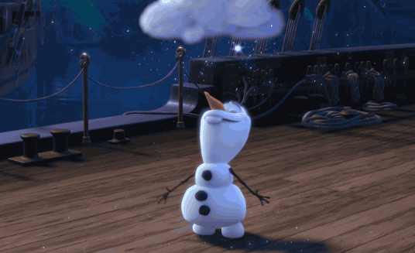
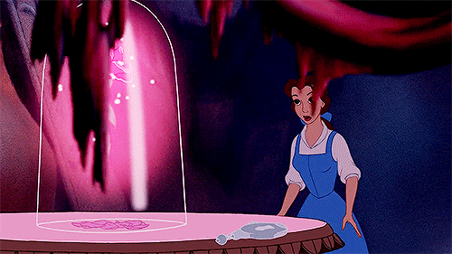
Nobody can deny that children like Disney characters so much.

Slide 27
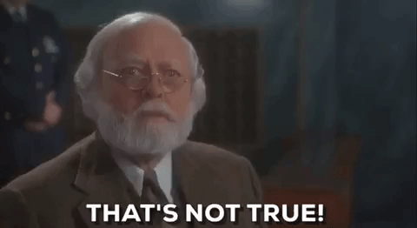
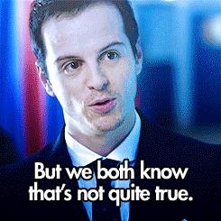
deny
to say that something is not true

Slide 28




Slide 29
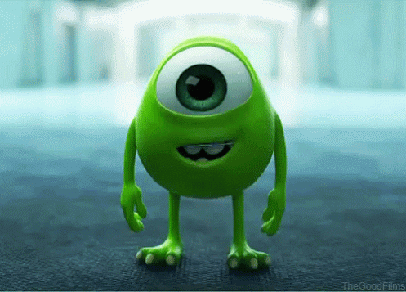
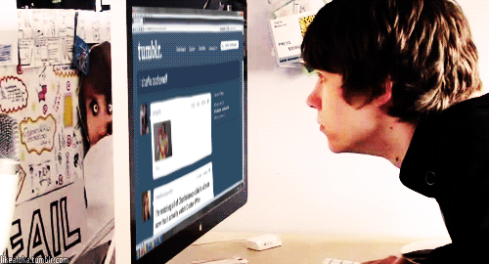

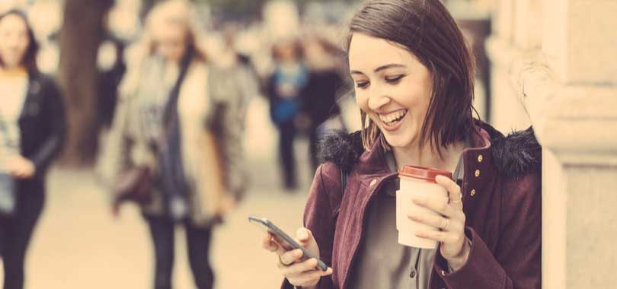
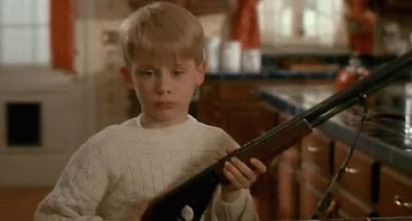

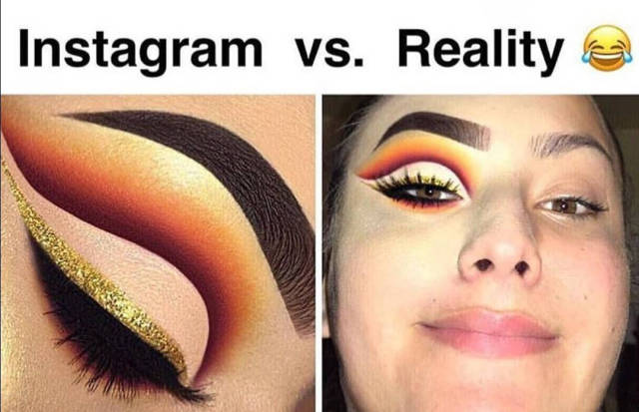
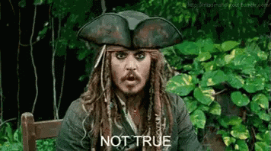
addiction (n.)
defend (v.)
obsessed (adj.)
confuse (v.)
unrealistic (adj.)
deny (v.)
necessarily (adv.)
in every case

Slide 30
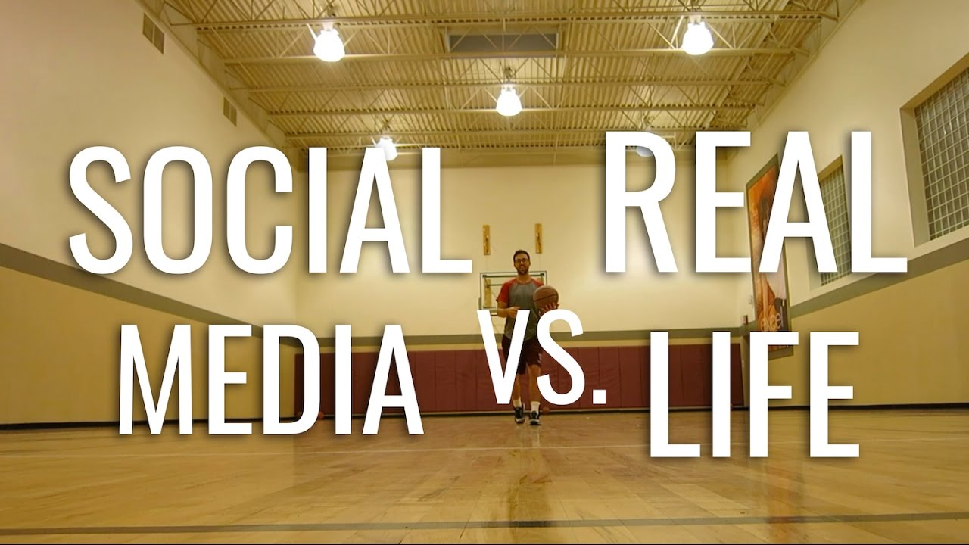

Slide 31
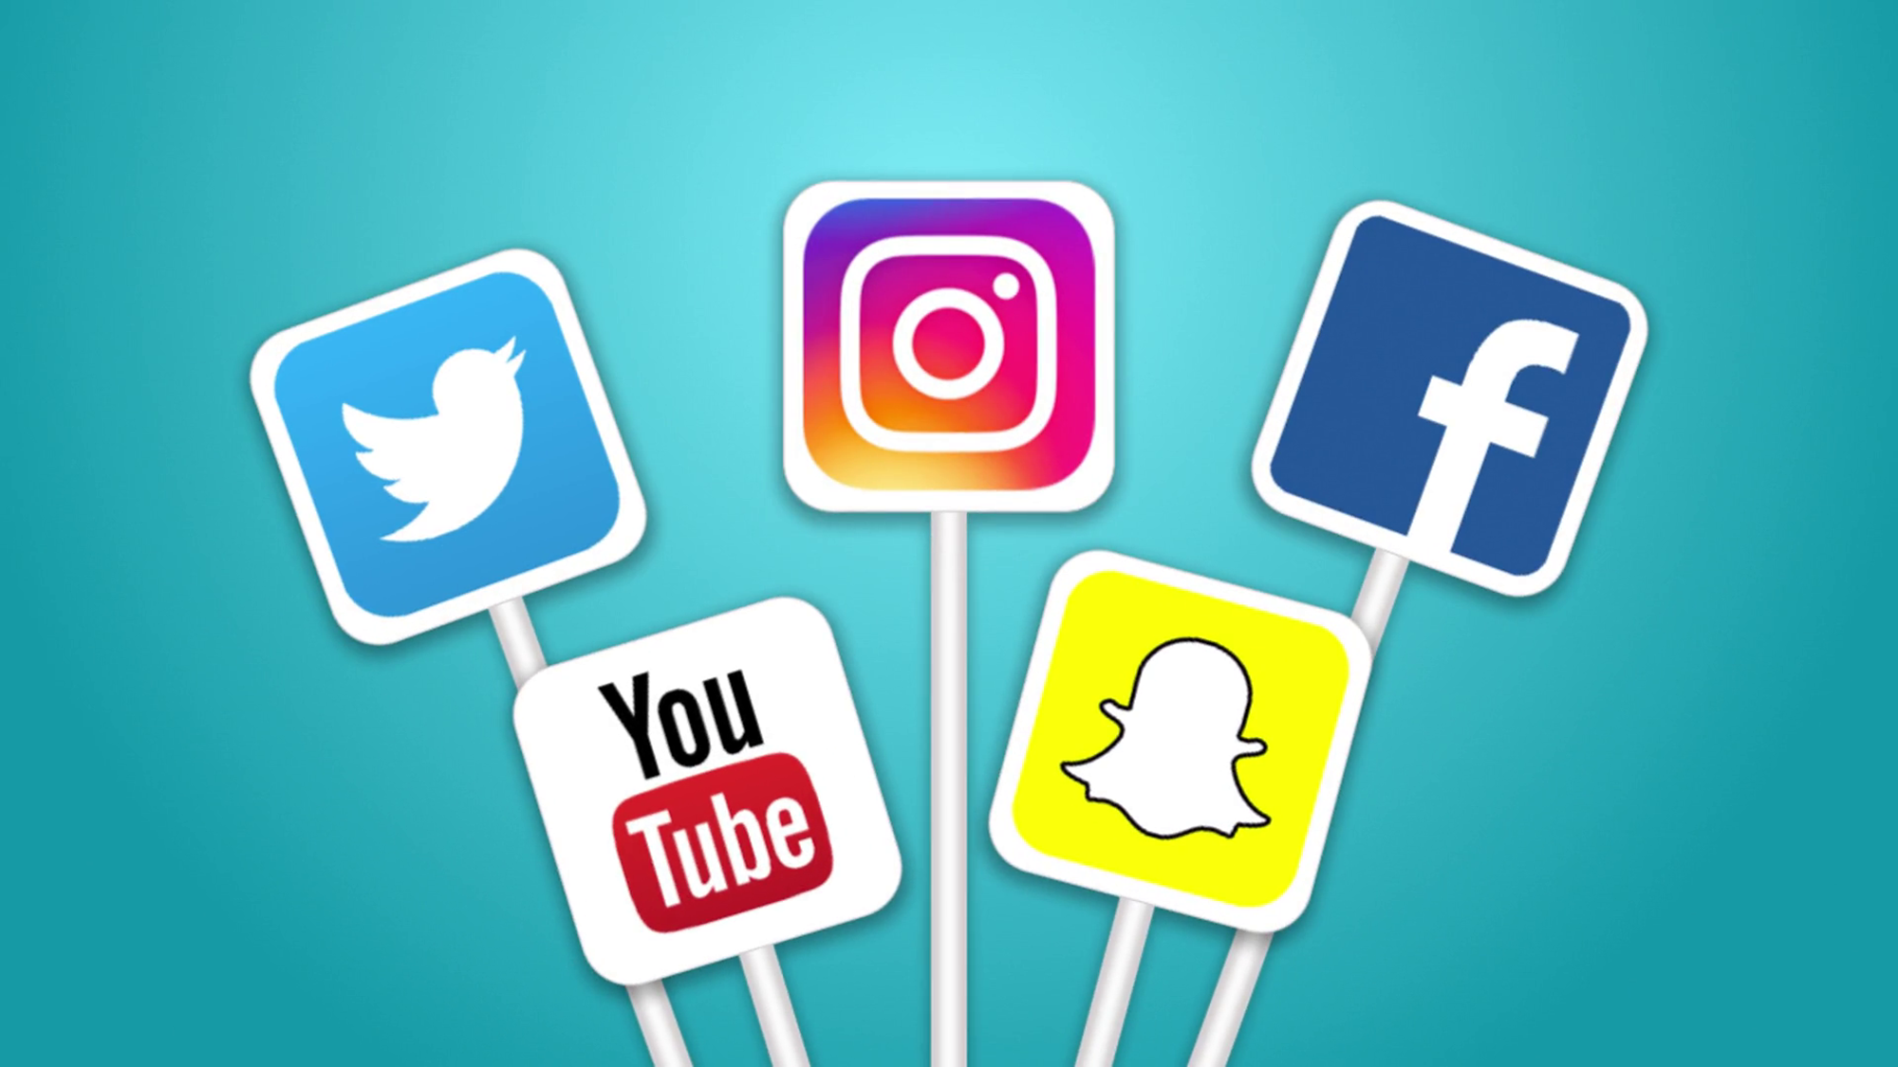

Student’s Book
Page 57

Slide 32
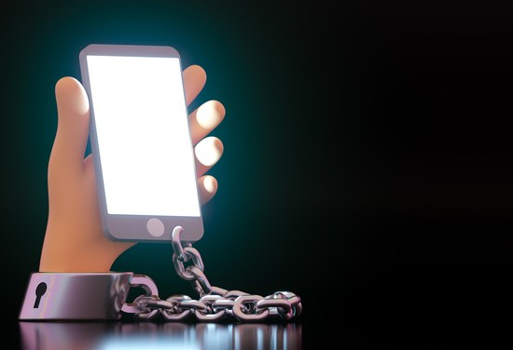



Slide 33


Slide 34
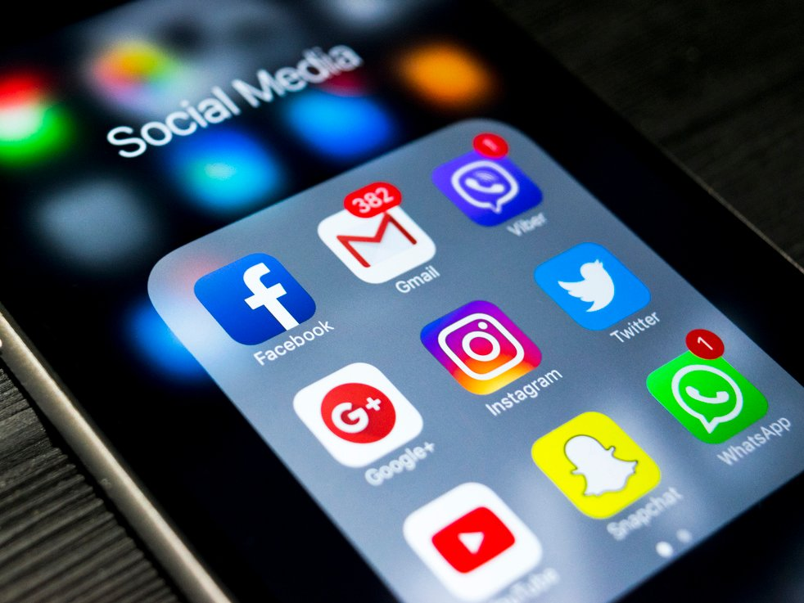
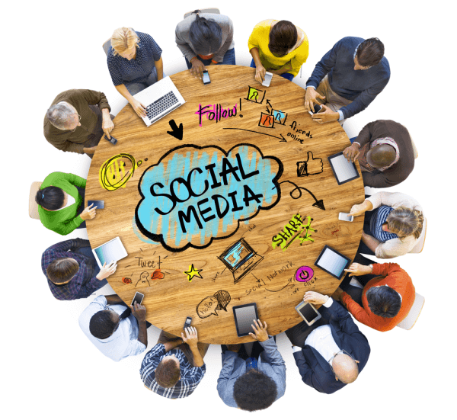
Read your answers.

Slide 35
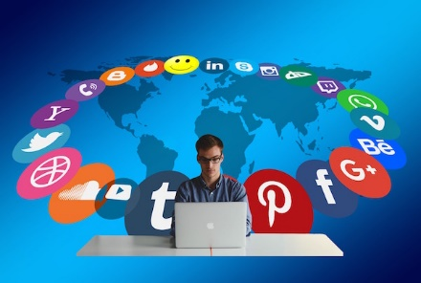

Give the text a title.

Slide 36

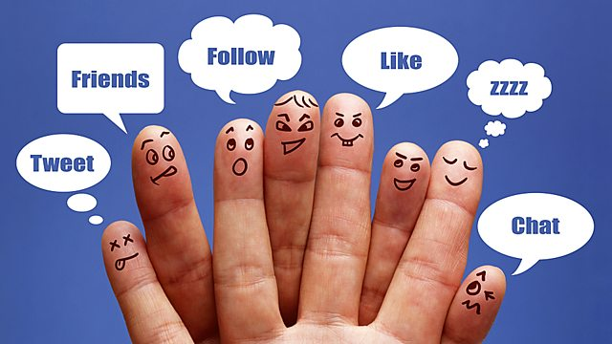
Student’s Book
Page 58

Slide 37



Slide 38
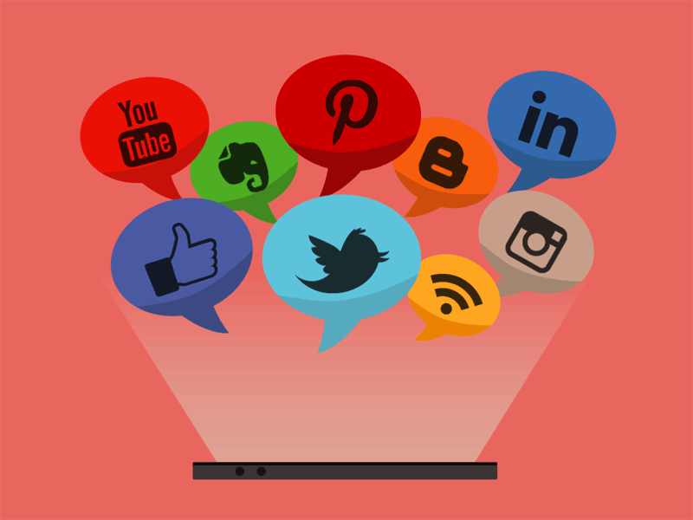
Check your answers.

Slide 39
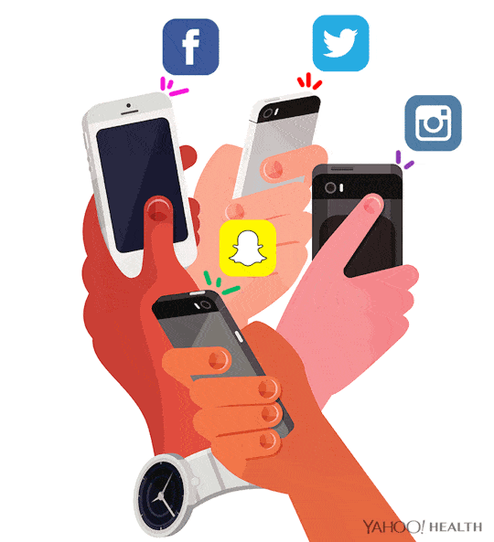
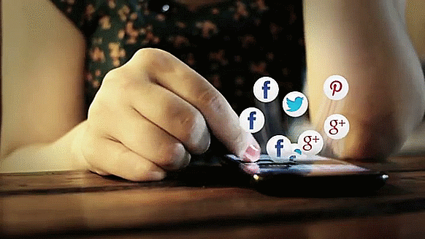
1. What does the author think the greatest problem with social media is?
The biggest problem is that using social media makes us less social in real life.

Slide 40






2. Which paragraph argues for social media and which one is against? How can you tell?
The second paragraph argues against social media.
The third paragraph argues for social media.

Slide 41
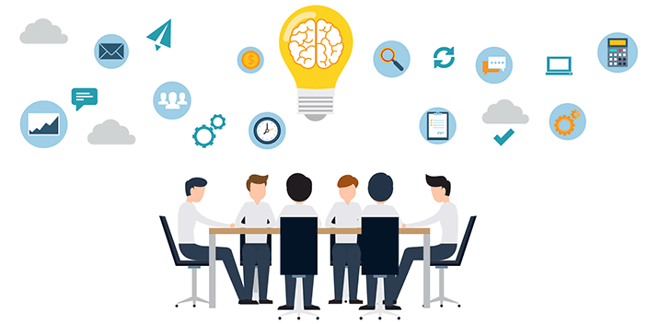
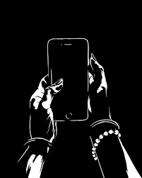
3. What does the writer think about social media?
In his opinion, social media is not necessarily a bad thing. Although using technology excessively is unhealthy, using it in the right way is a huge benefit of living in modern times.

Slide 42


4. What conclusions do you draw after reading this text?

Slide 43



Slide 44

Social media has become a huge part of everyday life. Some people see this constant use as an addiction to social media, but others defend it as a normal part of modern life and communication.

Slide 45
The biggest problem is that using social media makes us less social in real life. We can become obsessed with checking notifications or messages. This can lead us to ignore the people around us. Often, people confuse social media with reality. Having lots of Facebook friends doesn’t mean having a connection with those people in real life, and we forget that somebody’s ‘image’ online doesn’t always reflect that person’s real life. Lots of people only post positive things, so we believe their lives are perfect, and we spend a lot of time trying to live up to those unrealistic images.

Slide 46
Nobody can deny that these problems exist. However, social media has opened up many new possibilities, especially to young people. It allows us to stay in touch with friends around the world, see their pictures and hear about their adventures. Social media is also
a great way to raise enormous amounts of money for charity.
In my opinion, social media is not necessarily a bad thing. Although using technology excessively is unhealthy, using it in the right way is a huge benefit of living in modern times.

Slide 47



Slide 48

What is the purpose of the text?
a. to show the bad effects of social media
b. to know the icons of social media
c. to warn people from using the social media
d. to show the great impact of the social media

Slide 49


Slide 50

Closure

Slide 51

What would life be without social media?

Slide 52


Slide 53

Thank you

